Slide 1
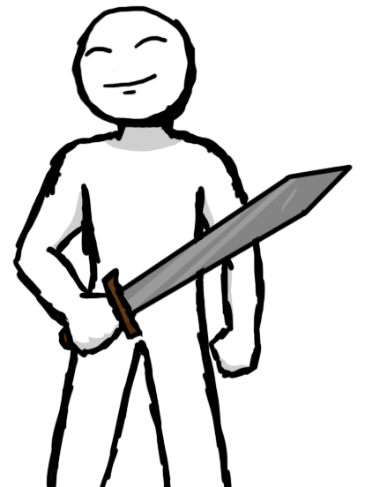
A Touch of Fun – The Creation of Dr. Meme
Kenneth Diedrich
Paul Doody
Alexander Rogic
Notes:
Alex

Slide 2
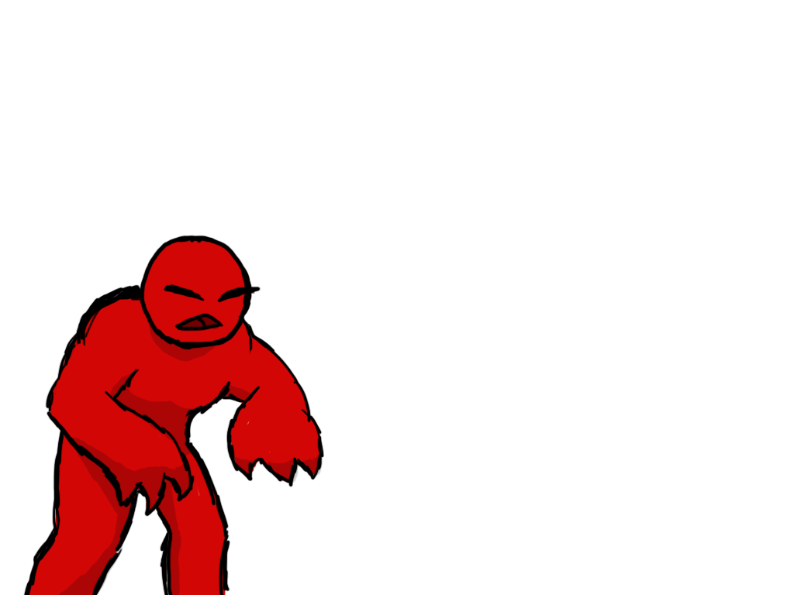
Overview
4
Unique genre to touch screens
To win? Survive the onslaught
Avoid death and prevent the castle from being overrun
Command troops and collect gear to aid your mission
Notes:
Paul

Slide 3

Idea Conception
3
Wanted to do something unique; bring a new type of game to touch screen devices
3D action – uncommon in current market
Turn-based strategy – works well
Notes:
Alex

Slide 4
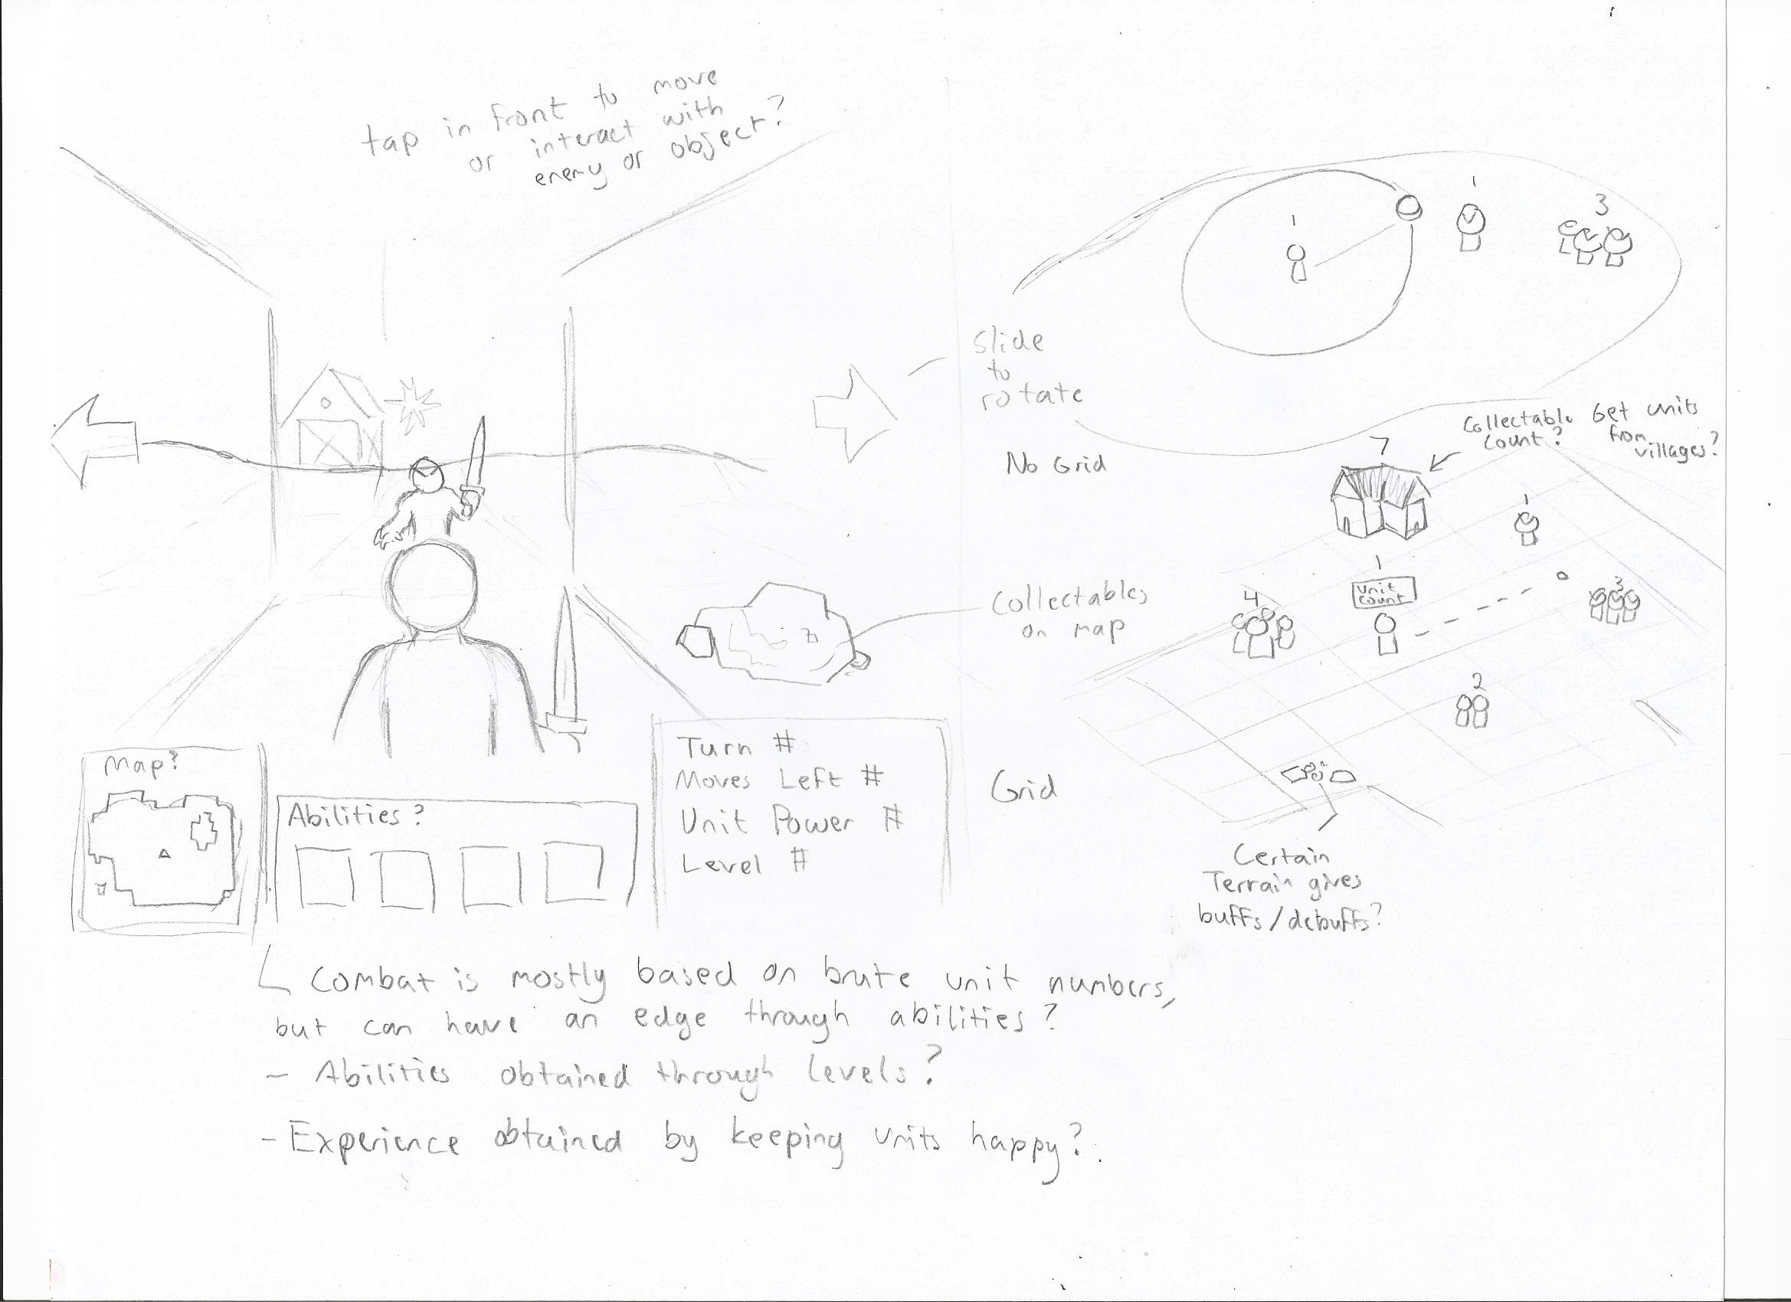

Slide 5
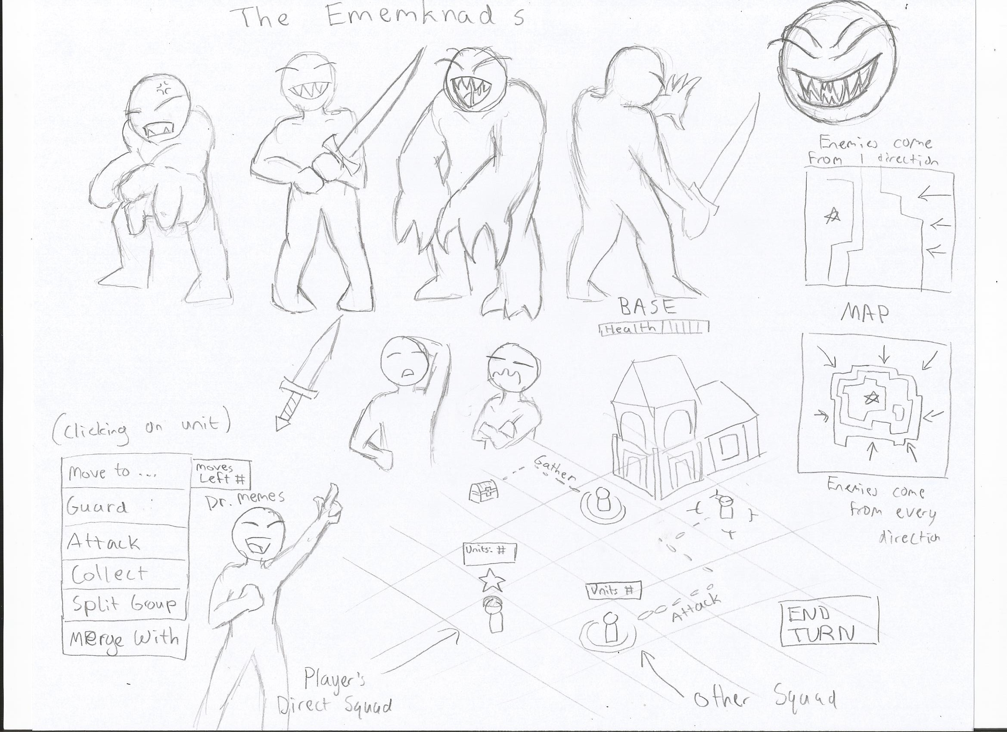

Slide 6
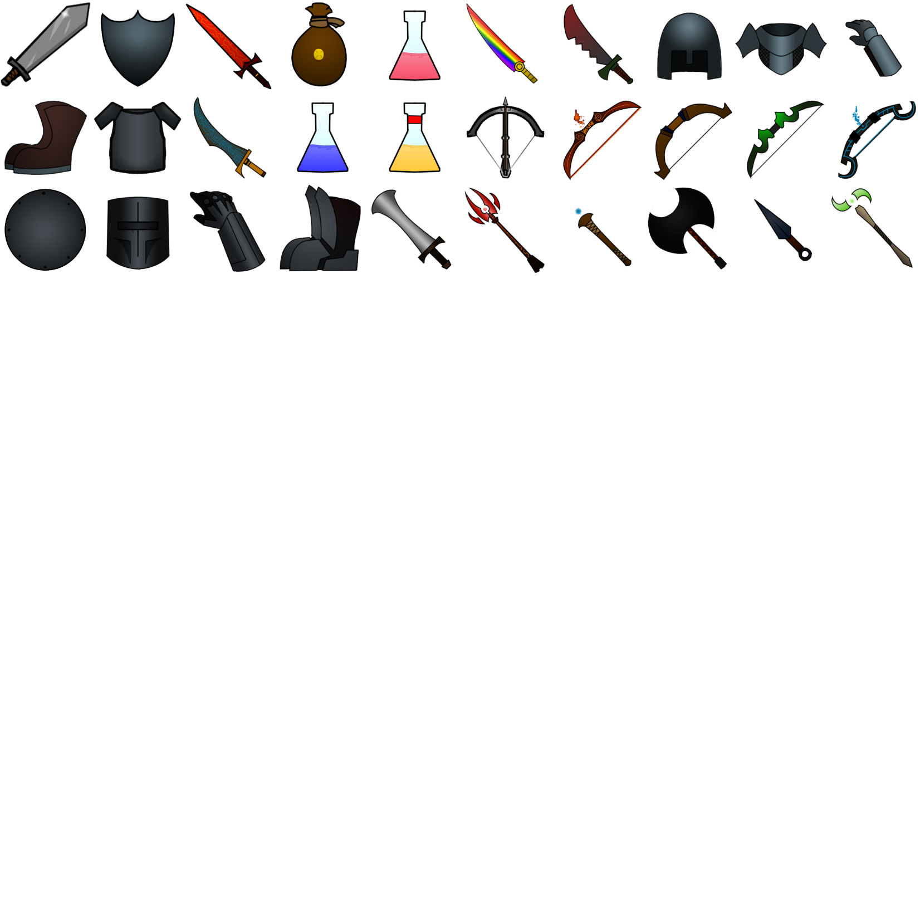
Design Challenges to Overcome
5
Developing for touch screen = limited user input
Balancing items and enemies
Establishing communication and scheduling outside of classroom
Syncing documents and collaborative software
Deciding team roles
Notes:
Kenny

Slide 7
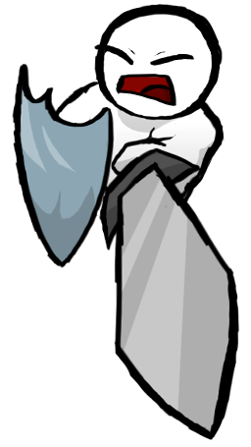
Tools Used
1
Unity (C#)
GitHub
Audacity
Mixamo
Soundation
Blender
Photoshop CC
Notes:
Alex

Slide 8
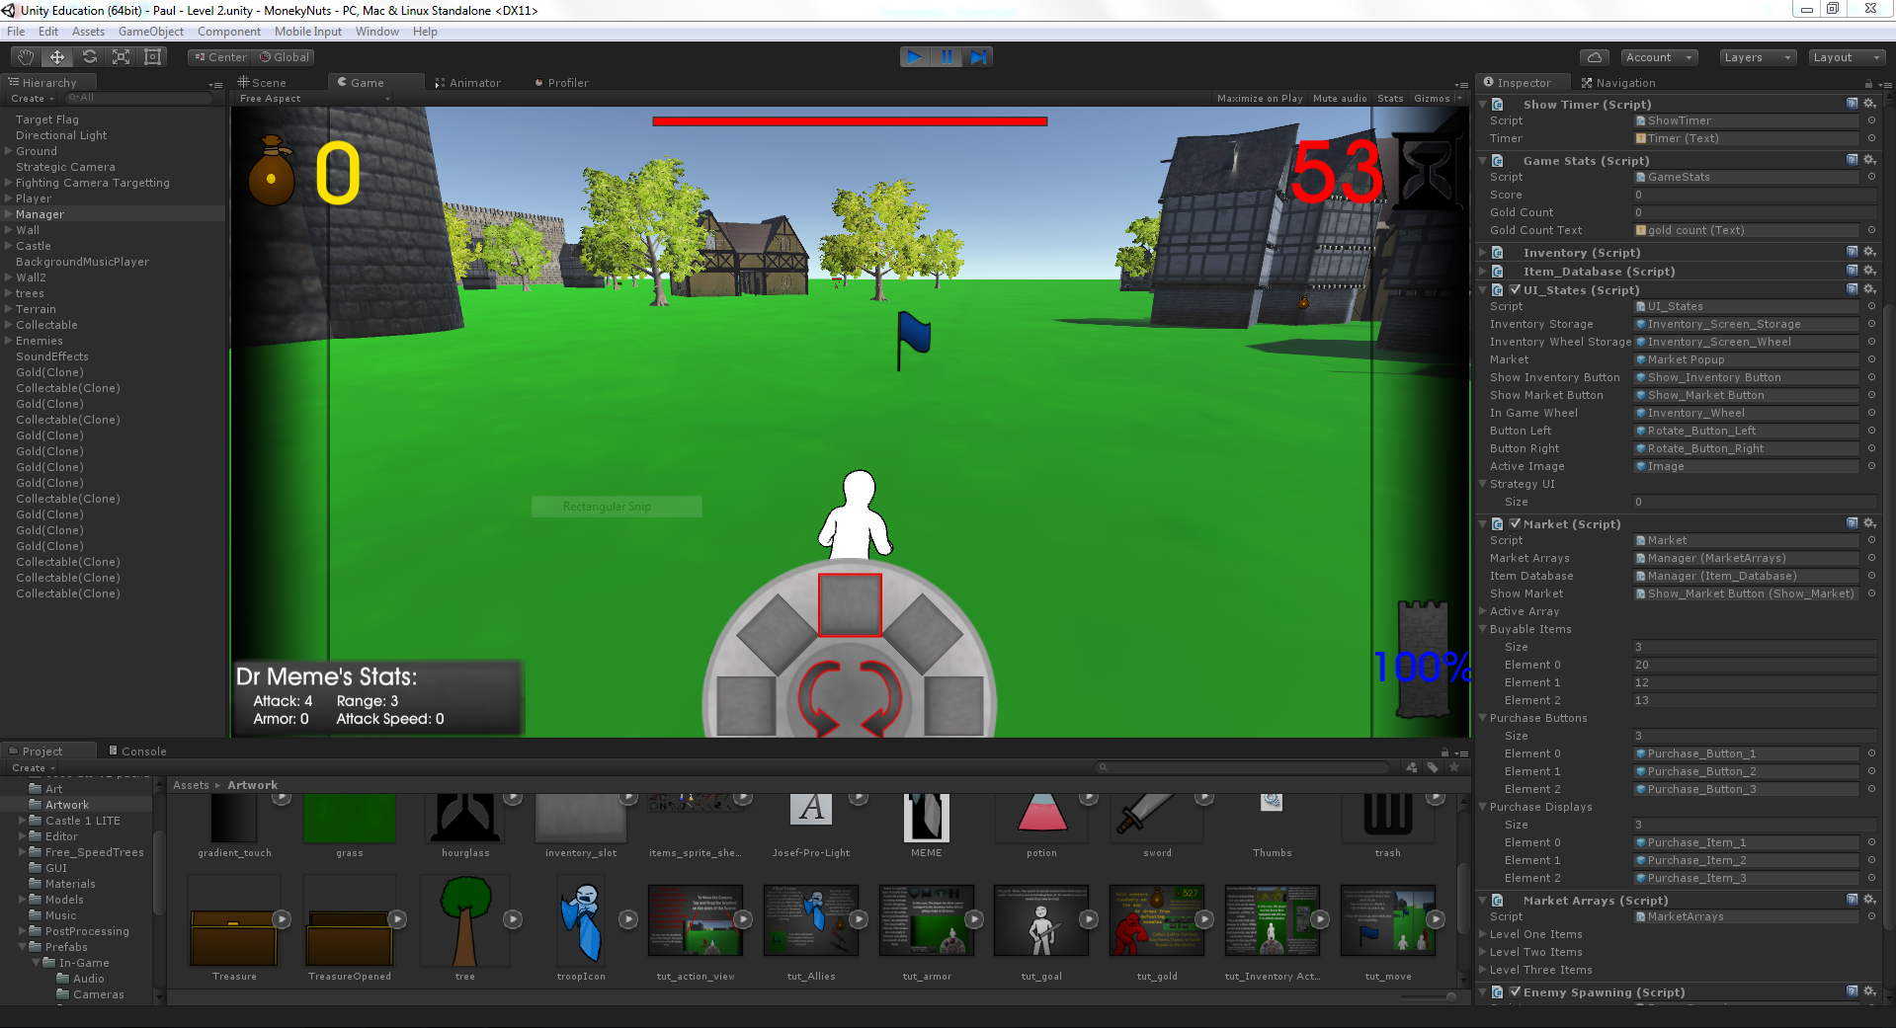
Tools uSed

Slide 9
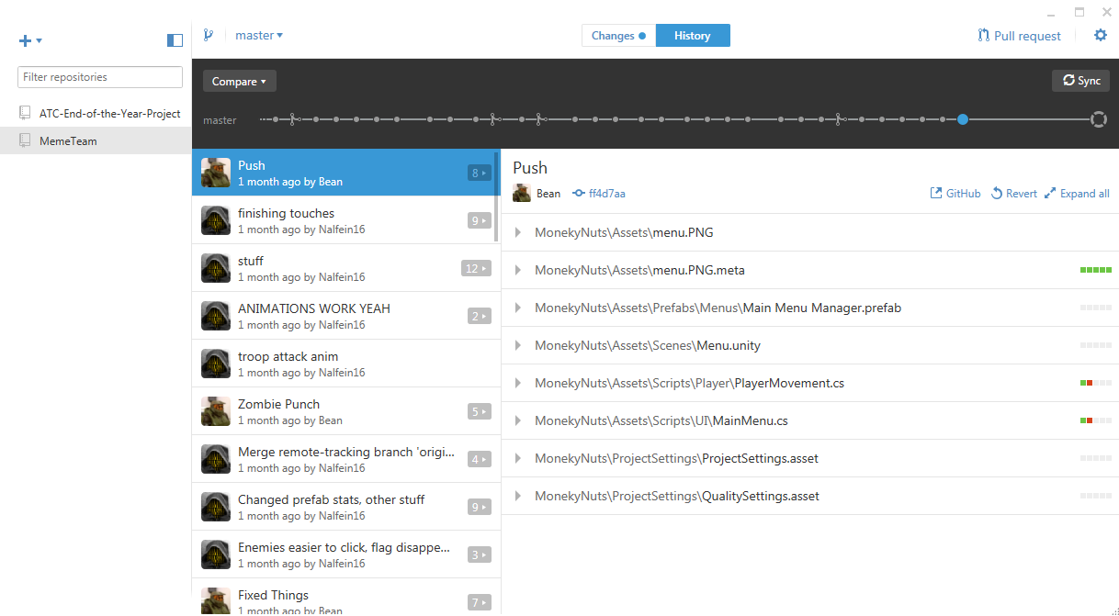
Tools uSed

Slide 10
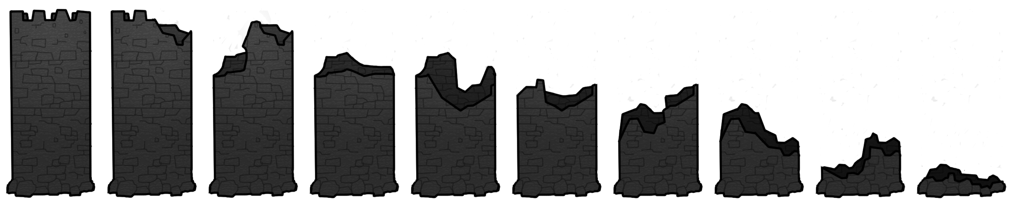
Inner Workings
3
States and timing
Player movement
Inventory and hot bar (active items and armor)
Notes:
Kenny and Paul

Slide 11
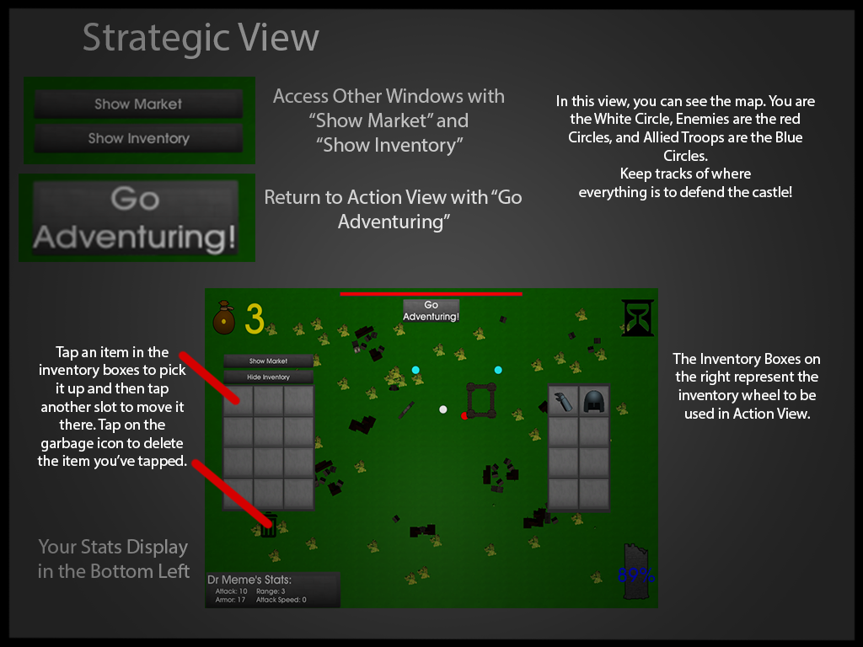

Slide 12
Inner Workings
4
States and timing
Player movement
Inventory and hot bar (active items and armor)
Enemy behavior
Intentions and Actions
Notes:
Kenny

Slide 13
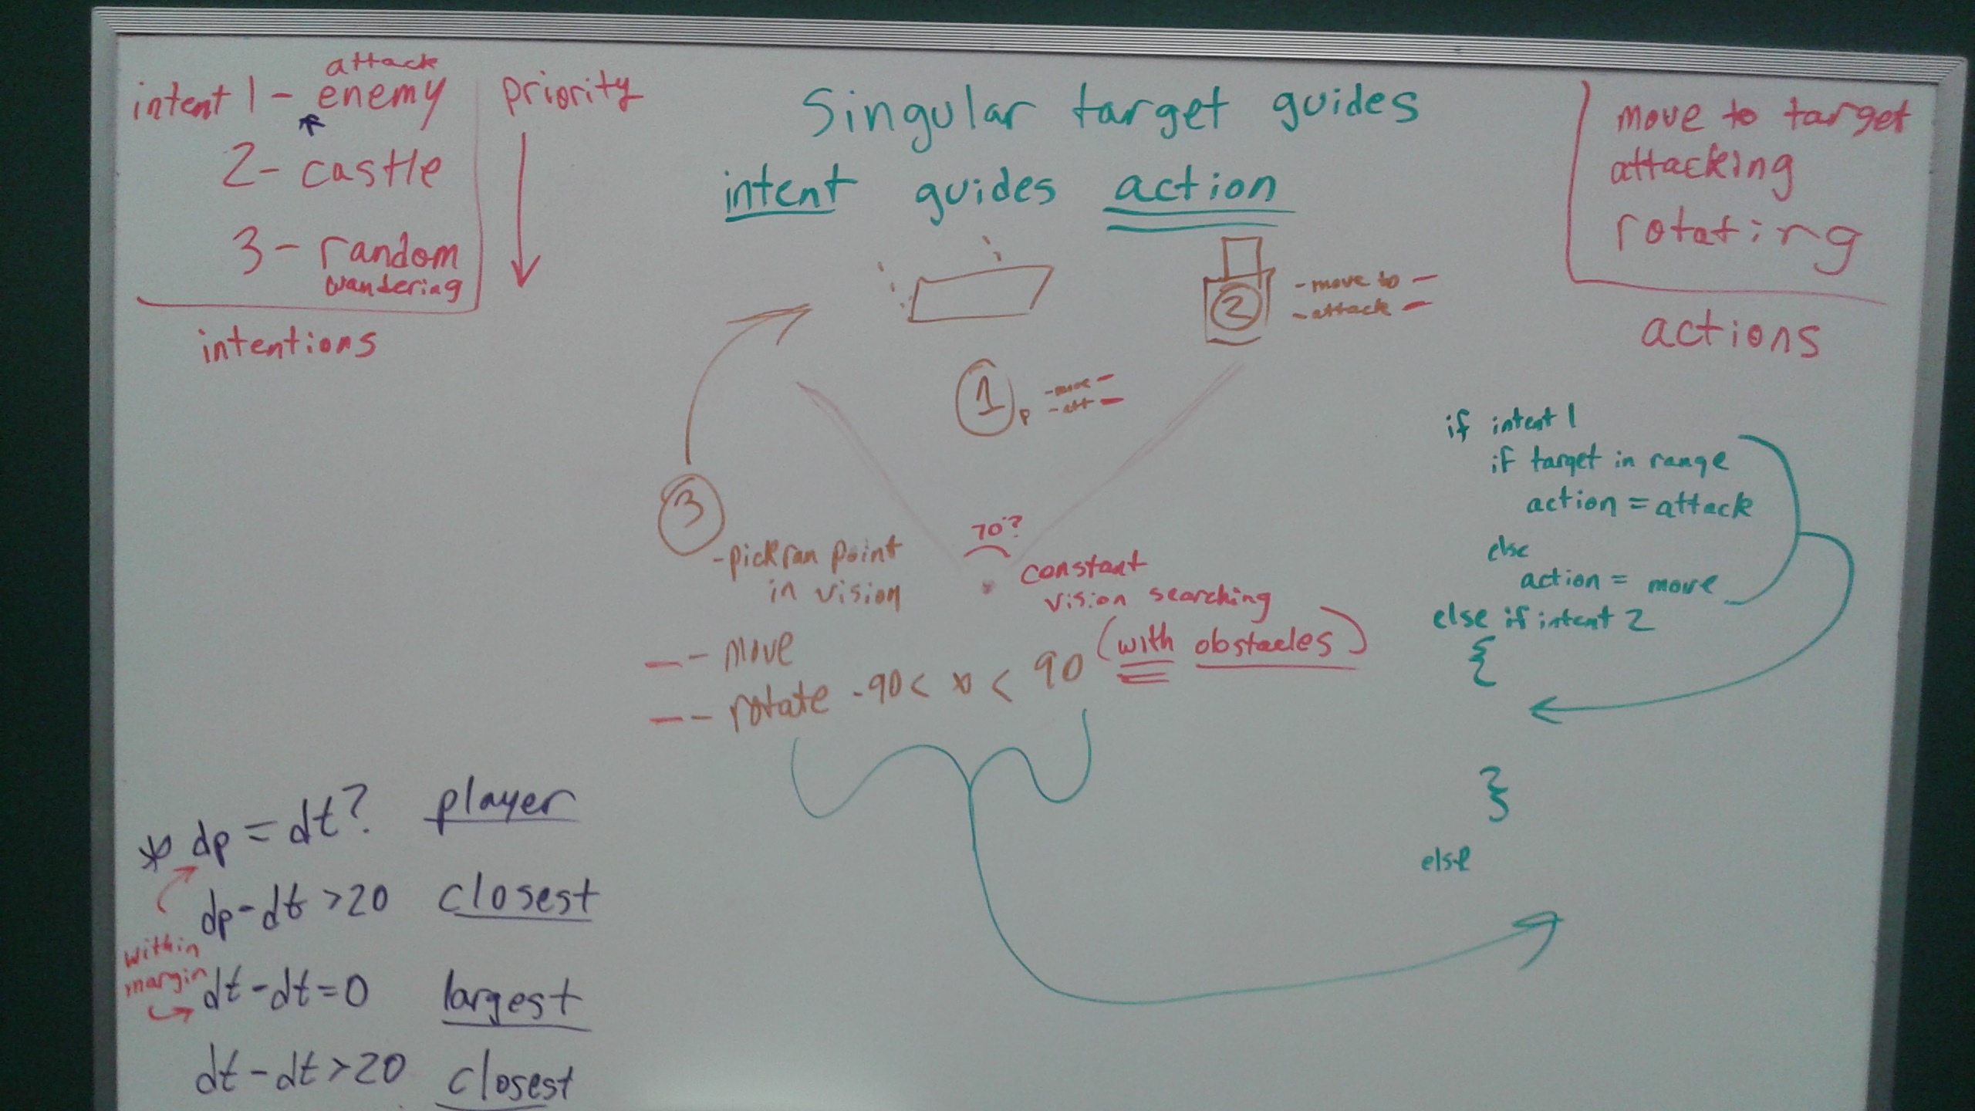

Slide 14
Creation Challenges to Overcome
6
Movement/camera issues
Commits wouldn’t push and overwriting resources
Miscommunication
Animations and graphics
Enemy/player logic redesign
Notes:
Kenny

